Slide 1

infrastructure projects India
Presented by Unit 12
Rapture
Impossible
Data Storytelling on
Notes:
Good evening everyone, me and Impossible are going to present the Infrastructure projects of India which are provided by the government of India on their website. So in the upcoming slides, we are going to represent the knowledge gained about these projects. We will talk about each and every project Feature in detail. So, The things we will be covering now will be:
We will also derive the project with the highest cost and the project with the lowest cost. We will talk about the undergoing projects and also completed projects, Then comes the State government projects and also the central government projects. We will also discuss those projects which have been completed on time and those which haven’t been completed on time. There are many insights we have gained through this project. So me and Impossible are going to share each and every valuable insight with you. So, Let’s start with the Dataset.

Slide 2
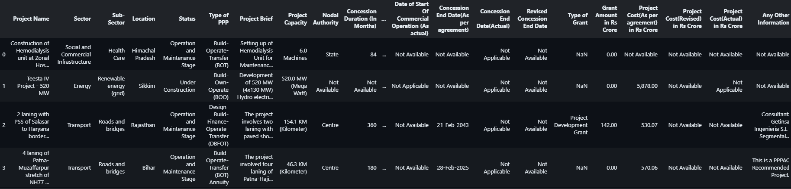
Project Dataset:
Notes:
In this slide, I am going to explain the dataset in detail. I am going to explain each and every important features that helped us in our analysis. There are 30 features for each and every project. We will not be talking about each and every feature, but we will discuss the most important ones. The project name is something obvious where we have the project’s name. Then we have the sector that the project belongs to. There are different sectors like Transportation, Communication, Social and Commercial Infrastructure Sector, Energy, and Water Sanitation. Coming to the subsector column, We have a subsector for each sector. For example, we have Renewable energy in the energy sector and Roads and bridges in the Transportation sector. Status describes whether the Project has been completed or if it is undergoing. Nodal Authority states whether the project belongs to the state government or the central government. Grant Amount in crores states the amount granted for the project development from the government. Project cost as per the agreement states the cost quoted for the project during the agreement phase. The actual project cost is the actual price for the development of the project. Revised project Cost is the new Project cost after making some increments and additions to the project cost as per agreement.

Slide 3
Initial Analysis:
Government projects
State and Central Government Projects
1825 projects
Multiple Sectors
1395 missing values in 'Type of grant’
Under-construction Projects
No duplicates
Notes:
In this slide, we will talk about the initial analysis that we have done from the dataset. We found out that all the projects in the dataset are government projects, and there are 1825 of them. One thing to notice, which you might have noticed in the previous slide is that some features have missing values and type grant is the feature that has the highest missing values. There are no duplicate values in the dataset. The dataset contains projects of multiple Sectors. Usually, we see datasets are sector-specific, which means each dataset contains projects related to a single sector. But in our dataset, there are projects from multiple sectors. There are both State and Central government projects. There are projects that are still undergoing and not yet completed. These are some key points we have noticed initially from our dataset.

Slide 4
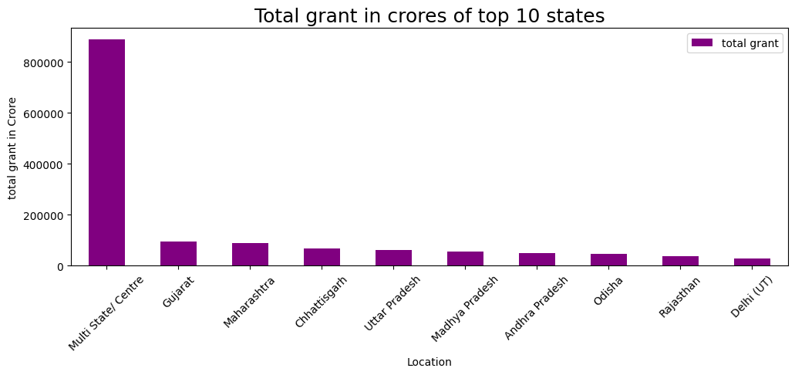
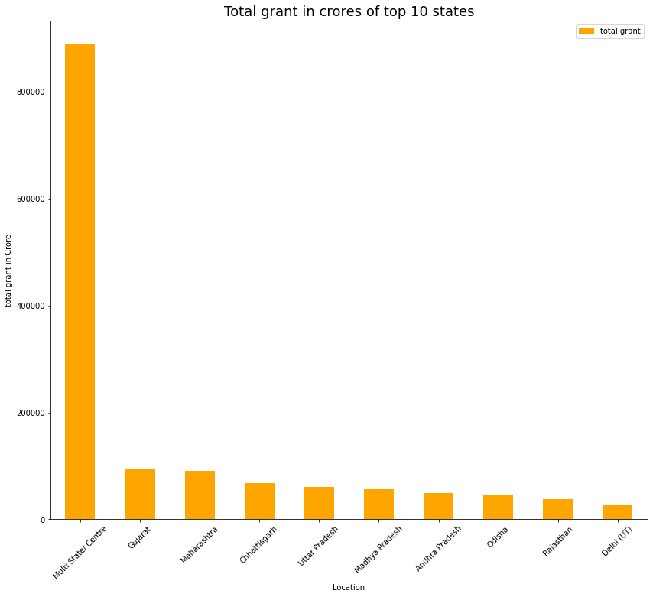
1
Notes:
In this slide, we will be discussing the total grant for different states. We will be using the bar graph to visualize the total grant for different states. The above graph shows the top 10 states having higher grants. The project cost plays a major role in any project. So We have worked on this feature and derived some valuable insights. The Infrastructure Project with the highest actual cost is Multi-State/ Centre which can be seen from the above graph. Since most of the big projects usually work in collaboration with multiple states, Multi-State/ Centre has the highest grant. But If we look at individual states, in that case, Gujarat has received the highest grant of around 1 lac crore. We have fetched the top 10 states with the highest project investments (funding).

Slide 5
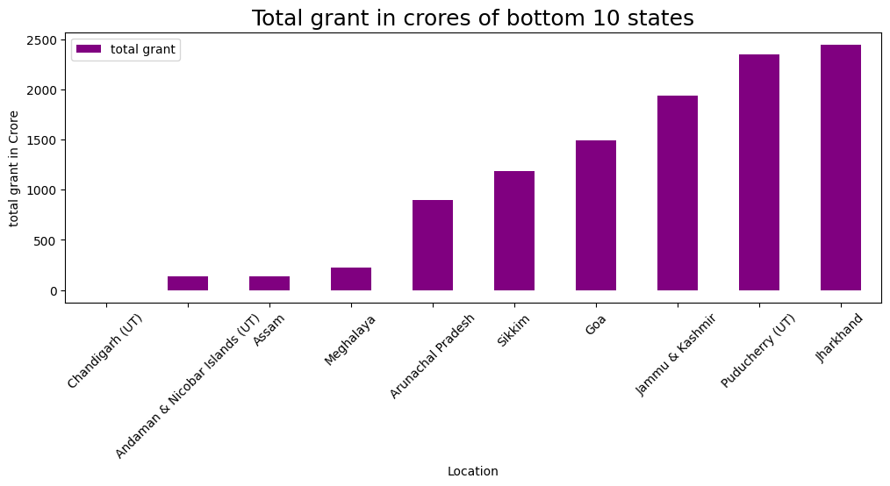
1
Notes:
These are the bottom 10 projects with respect to the grant amount in crores. From the above graph, we can clearly observe that Chandigarh has the lowest grant amount when compared to the other states. Then comes Andaman and Nicobar Islands followed by Assam, Meghalaya, Arunachal Pradesh, Sikkim, and so on… These states have the lowest grants hence they are labeled as “Total grant in crores for bottom 10 states”. In this set of 10 states, Jharkhand, Puducherry and Jammu and Kashmir have the highest grants.

Slide 6
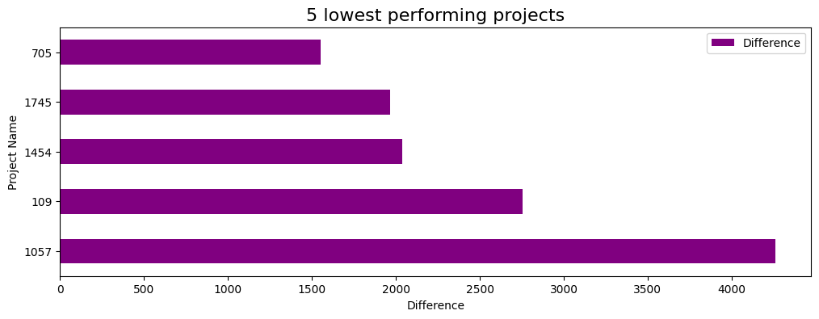
2
Setting up of 1000 MW
Mumbai Metro Line I
Kanyakumari Operation
6 laning of Ahmedabad
Yamuna Expressway Connect
Notes:
This slide covers the difference between Actual Project costs and agreed Project costs which will present the more inefficient projects. More the difference between the actual project cost and the agreed project cost describes the higher inefficiency of the project. The projects mentioned in the above graph have a huge difference between their actual project cost and the agreed project cost. The project named Yamuna Expressway has a difference of 4261 crores between the actual cost and the agreed cost. 4200 crores is a whooping amount which generates a negative impression on the team associated with this project.

Slide 7
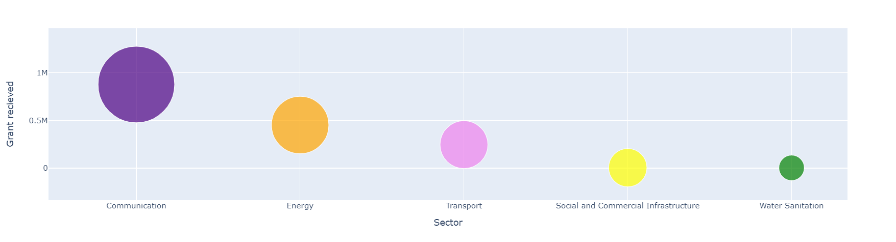
Top 5 Sectors and their grants
3
In the X-axis, moving from left to right decreases the Grant amount.
Communication has the highest grant.
Water Sanitation has the lowest grant.
Notes:
In this slide, we will be discussing the different sectors that are present in the dataset. Communication, Energy, Transport, Social and commercial infrastructure, and water sanitation are the five different sectors. Communication sectors deal with Cell phone towers and projects related to mobile networks. Energy Sector deals with Energy generation or power generation. Wind Energy, hydraulic energy, and Electric Energy come under the Energy sector. Social and commercial infrastructure deals with health and social-related projects. Water Sanitation deals with cleaning and purifying water. Water purifying plants are part of the Water Sanitation Sector. The communication Sector has the highest grant around 8 Lakh crores which is a whopping amount. Then comes the energy sector, followed by Transportation Sector and Social and Commercial infrastructure. The water sanitation Sector has the least amount of grants compared to all the other sectors.

Slide 8
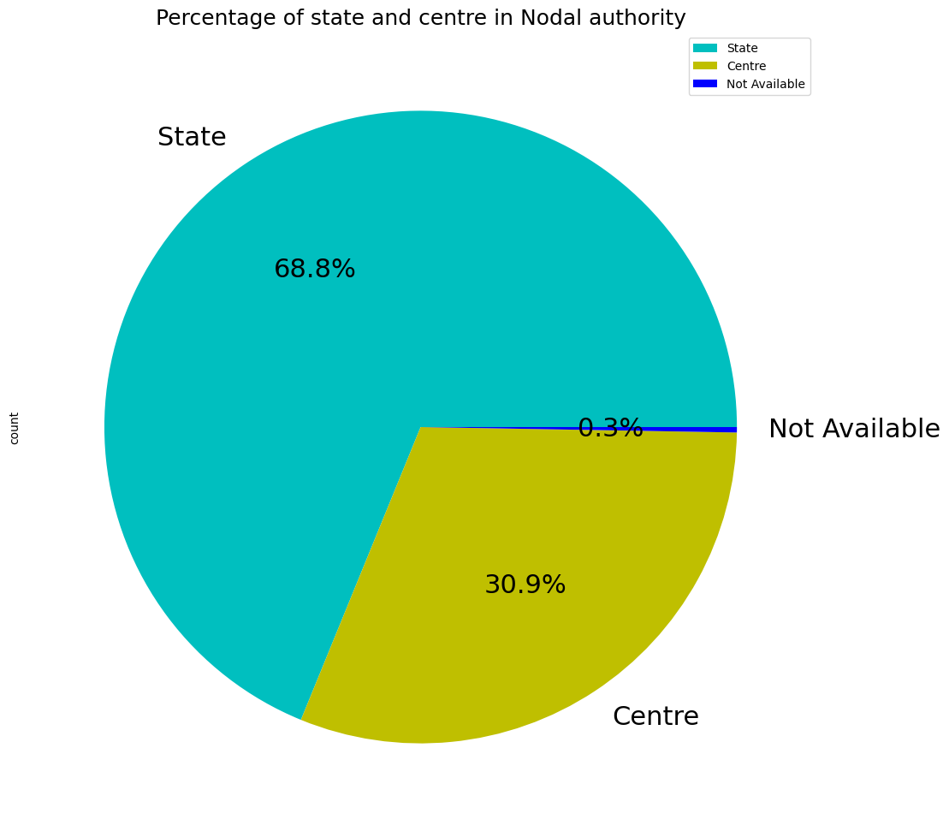
4
Notes:
In this slide, we will discuss the Projects that belong to the state and central government. There are projects that belong to a specific state which are called state government projects and there are projects with high budgets and where the central government involves which are called central government projects. So in our data set Nodal authority is a feature that describes whether a project belongs to central government or state government. If we take a look at the above graph, there are approximately 70 percent of the projects from our data set belong to the state government which is represented by a sky blue color, and 31 percent of the projects belong to the central government which is represented by a yellow color.

Slide 9
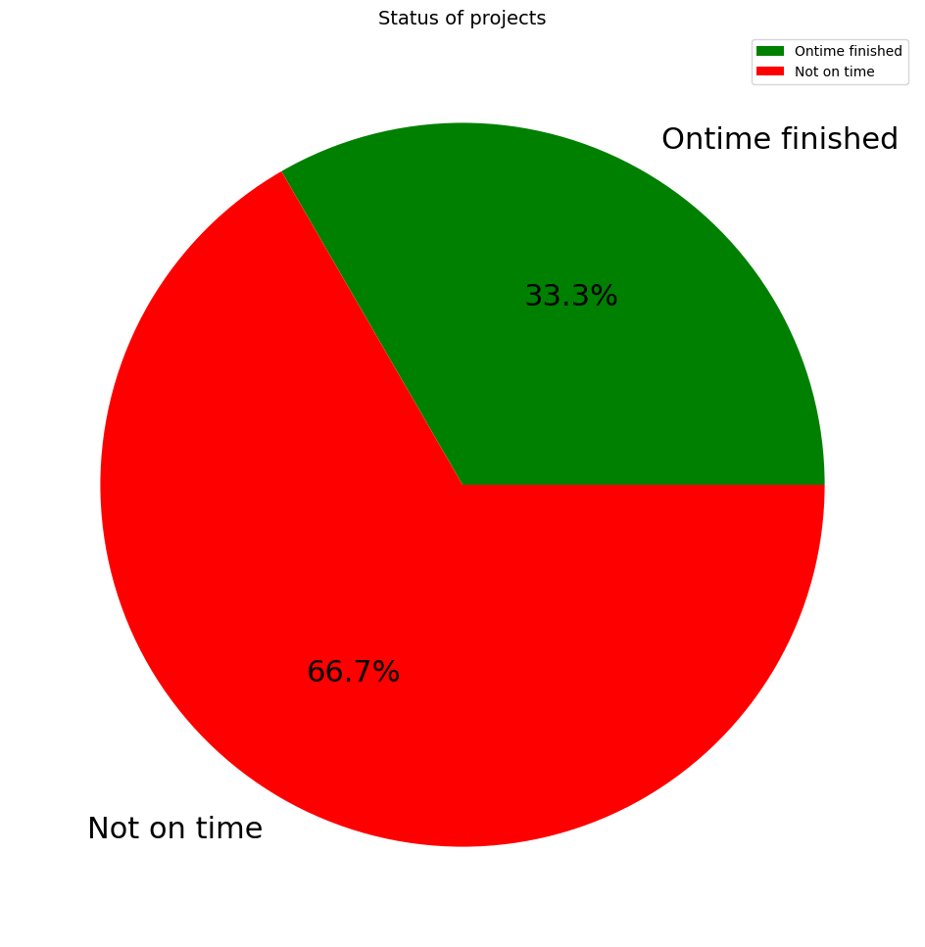
Notes:
In this slide, we will discuss the projects that have been completed on time and the projects that haven’t been completed on time. If the Actual project completion date is less than or equal to the agreed project completion date, then we can conclude that the project has been finished on time. If the Actual completion date is greater than the agreed date, then we can conclude it as a project that’s not completed on time. In the above pie chart, we can observe that there are approximately 67 percent of the projects have not been completed on time which is represented using the red color and there are 33 percent of the projects that have been completed on time which is represented using the green color.

Slide 10
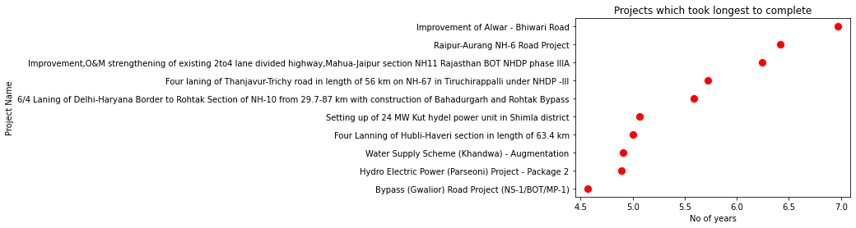
6
Notes:
In this slide, we will discuss about the projects that took the longest to complete.
1. These projects have taken longer than anticipated.
2. Project delays can be due to changes in plan, lack of communication, and unavailability of resources.
3. It is obtained by calculating the difference b/w the Construction completion (Agreed) date and the Construction completion (Actual) date.
4. These projects are considered outliers.
5. Improvement of the Alwar-Bhiwari road project has taken the longest time to complete which is 7 years.
6. Project delays can be avoided by setting proper plans, gathering the right resources, conducting meetings, etc

Slide 11
Under construction projects
7
No of projects | Cost as per agreement in crores | Revised project cost in crores
340 | 216827 | 62139
Notes:
In this slide, we will discuss the Under-construction projects.
1. Projects that are incomplete can be identified using the status attribute.
2.The cost of the project can go below or above the agreed project cost which is called as revised project cost.
3. There can be many reasons to why projects are not completed within the estimated budget. It can be due to human errors, environmental factors and loss through damages.
4. There are 340 projects that are in the under-construction phase.
5.Total Cost as per the agreement for these projects is over 200000 crores
6. Total Revised project cost for these projects is around 62000 crores.

Slide 12
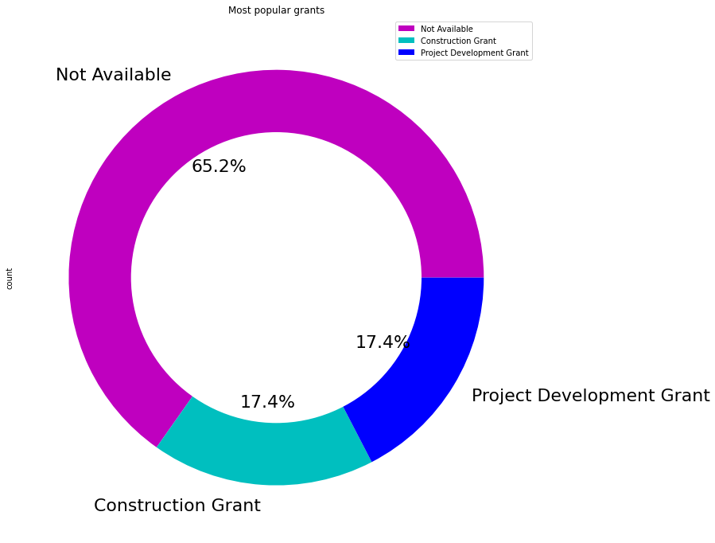
8
Notes:
In this slide, we will discuss the most popular grants.
1. The donut chart shows the most popular grants in Social and infrastructure sector.
2. The projects can be classified into popular categories based on the repetition and number of occurrences.
3. About 65% of the projects under construction have not received any grants.
4.35% of the projects have received grant amounts and are equally divided into Construction and project development grants.

Slide 13
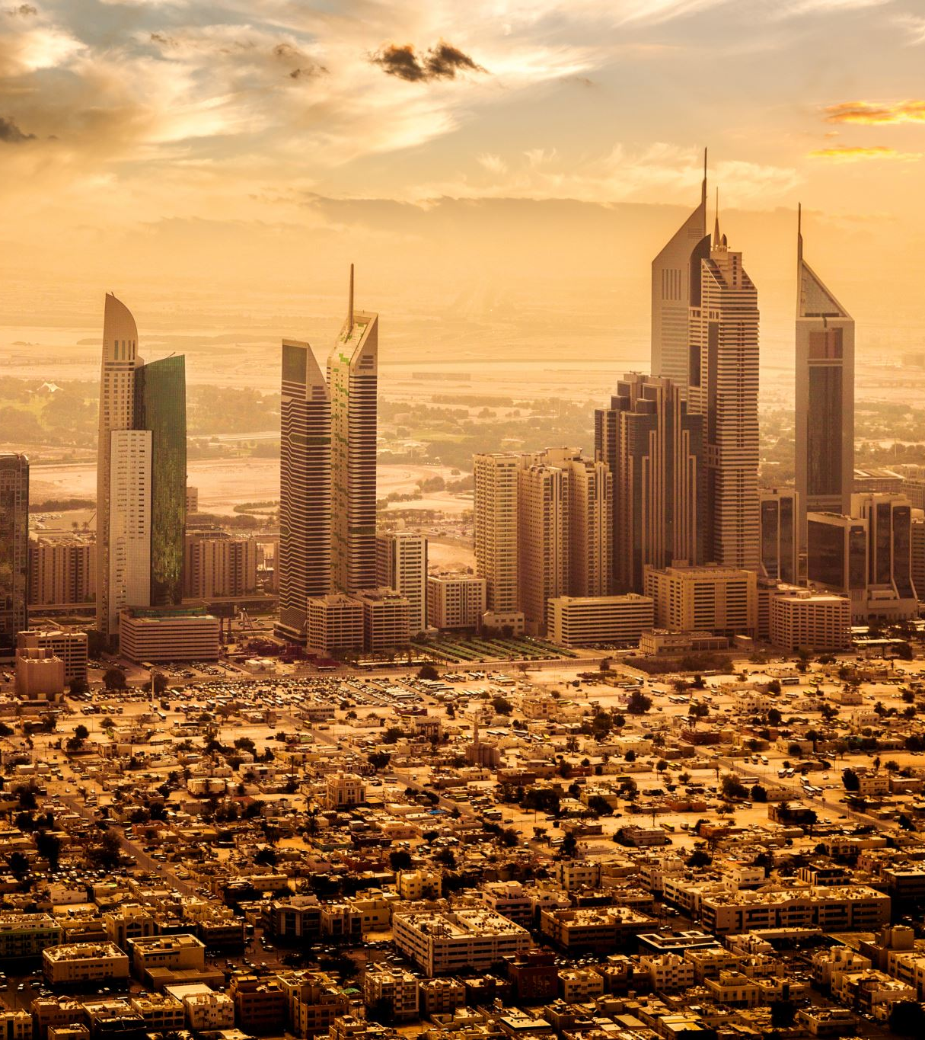
The top most expensive projects
Bharat Sanchar Nigam Limited – 1,70,000 Crores
IDEA India Limited – 75,000 crores
Bharti Airtel Limited investment – 65,000 crores
Reliance Communication – 55,000 crores
Reliance Jio Infocom Limited – 52,000 crores
Notes:
In this slide we are going to look at some of the expensive projects.
1. It is derived from the actual project cost in crores.
2. Many projects require more than the agreed project cost to complete their projects.
3. To avoid budget overrun, the company must focus on factors like project status, identify the problems and adjust key result areas.
4. Bharat Sanchar Nigam Limited is the most expensive project and it has cost around 175000 crores. The next five expensive projects are,
IDEA India Limited
Bharti Airtel Limited investment
Reliance Communication
Reliance Jio Infocom Limited

Slide 14
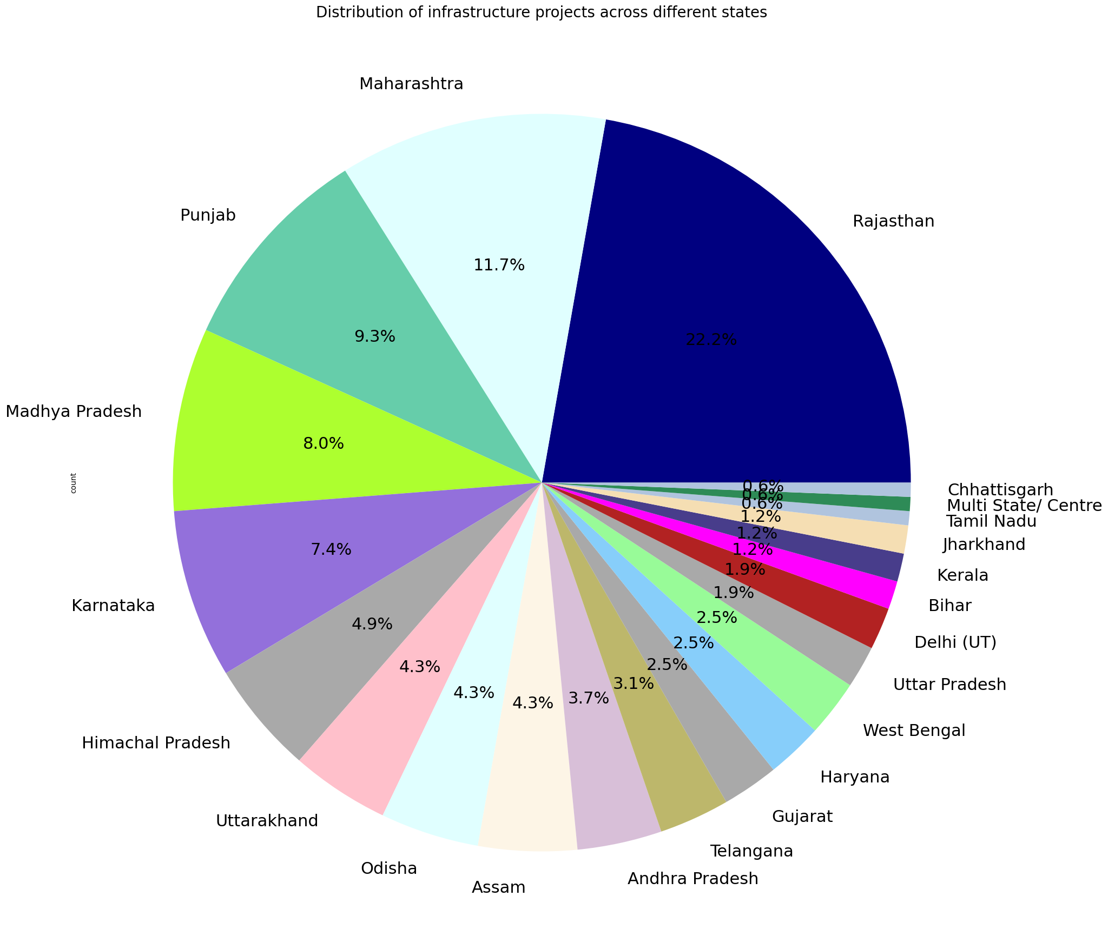
10
Notes:
In this slide, we will discuss the distribution of infrastructure projects across different states.
1. Social and infrastructure projects involving the maintenance of social services like housing, health, and water supply.
2. There are 162 projects in the sector ‘Social and infrastructure projects’.
3. Rajasthan being the largest state, has undertaken 36 projects out of the total infrastructure projects.
3. Maharashtra and Punjab are the next two states that have major contributions to infrastructure projects.ie 19 and 15 projects respectively.
4. Chattisgarh, multi-state/center, and Tamil Nadu have the least contribution to infrastructure projects and have undertaken 1 project each out of the total infrastructure projects.

Slide 15
Conclusion
The more the difference, the performance gets worse, and vice versa.
340 projects under construction.
Communication Sector – 895734 crores of grant.
Project should be completed on or before the agreed date.
Delayed project means a date greater than the Agreed date.
Suggestions:
Do not entertain Companies/Organisations which are taking more time to complete projects.
Give more resources and hand over more projects to Chattisgarh, Assam, and Meghalaya.
Do not spend 3-4 years on a single project.
The organizations should be disciplined and finish the projects on time.
Can impose penalties or fines if the agreed completion date has crossed.
Notes:
We would like to conclude by highlighting the key insights we have gained by working on this project. The more the difference between the actual completion date and the agreed completion date, we can say that the project has lesser performance. There are still 340 projects which are under construction. The communication sector has the highest grant consumption of around 8,00,000 crores. Many of the projects are not completed on time which implies that most of the projects are not getting completed in/or time.
My Mate Rapture will highlight some suggestions that we would like to give to the government based on these conclusions made.
I would like to suggest the government not give contracts to the organizations which didn’t complete the projects on time and took much longer than the agreed date. There are 3 women polytechnic projects in the state of Rajasthan which took almost 3-4 years to complete. 3-4 years is a very long time and a lot of resources will be wasted in those 3 years. So I would like to suggest the government give the contract to the right organization and complete the project with high quality in a considerable amount of time. Chandigarh, Assam, and Meghalaya states have low grants compared to other states which implies there is less development in those states. So I would like to recommend the government hand over more projects in those regions. I would also suggest not to spend 3-4 years on a single project. The government can also impose fines or penalties on the companies that haven’t completed the projects on time.

Slide 16

Notes:
Thank you for your valuable time. Hope you all gained some valuable insights from the session and also grabbed some knowledge regarding the Indian government projects. Thank you.

